Slide 1






Team Members
MIS 6382.501 (Object Oriented Programming In Python) Data Visualization Project Group - 2
Sai Thushara Chowdary Chundru Venkateswara Prasad
Radhika Dubey
Jagannath Kumar
Submitted To:
Professor Rabih Neouchi
Sadaf Riaz
Aditya Praveen Yewankar

Slide 2




Agenda
Introduction
Data Types
How to deal with missing values
Visualization Types
Bar chart
Pie Chart
Line Chart
Histogram
HeatMap
Box Plot
Scatter Plot
Trends at a Glance
Conclusion

Slide 3
Introduction
The data set contains information about different company's financial fluctuations over a while by noticing the change in the price of their stocks followed by the change in price. To begin with, the dataset has 10000 rows of data with the following columns:
Column | Data Type
uniqueID | int 64
date | object
company | object
index_name | object
type | object
rating | float 64
price | float 64
fluct_rate | float 64

Slide 4

How To Deal With Missing Values
Numerical Columns
Date Column
Median
Mode

Slide 5

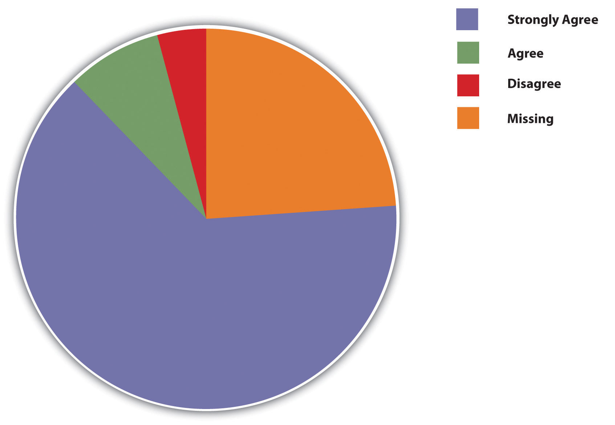
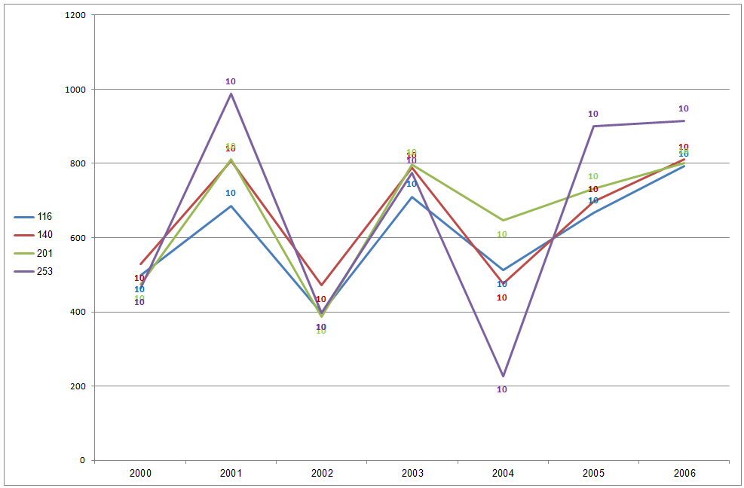
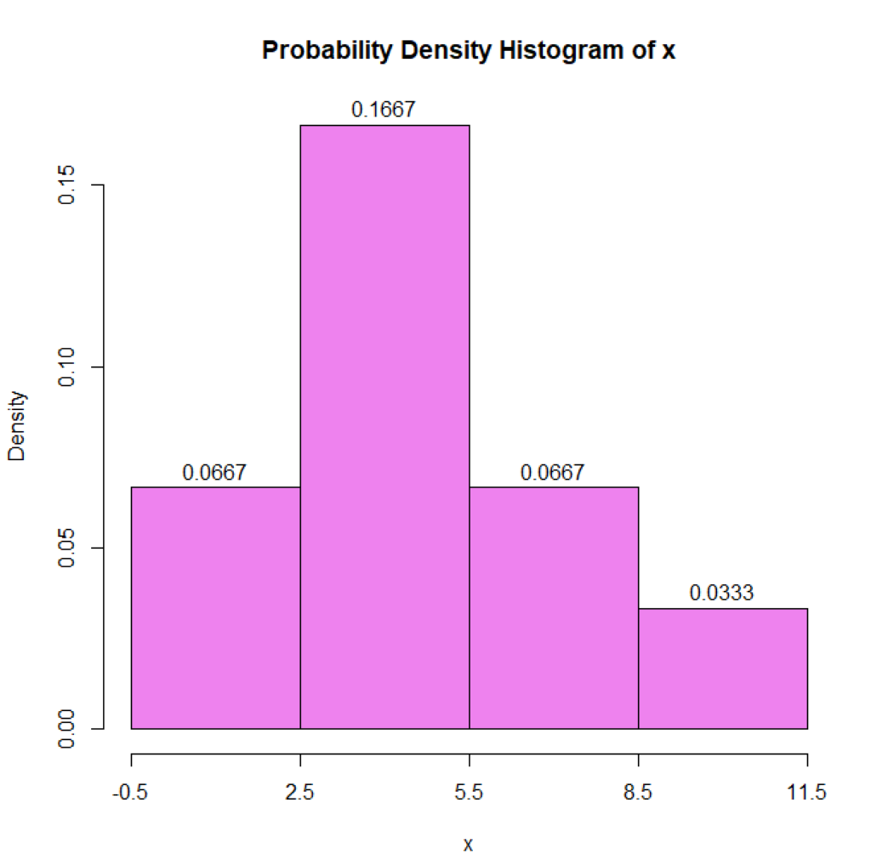
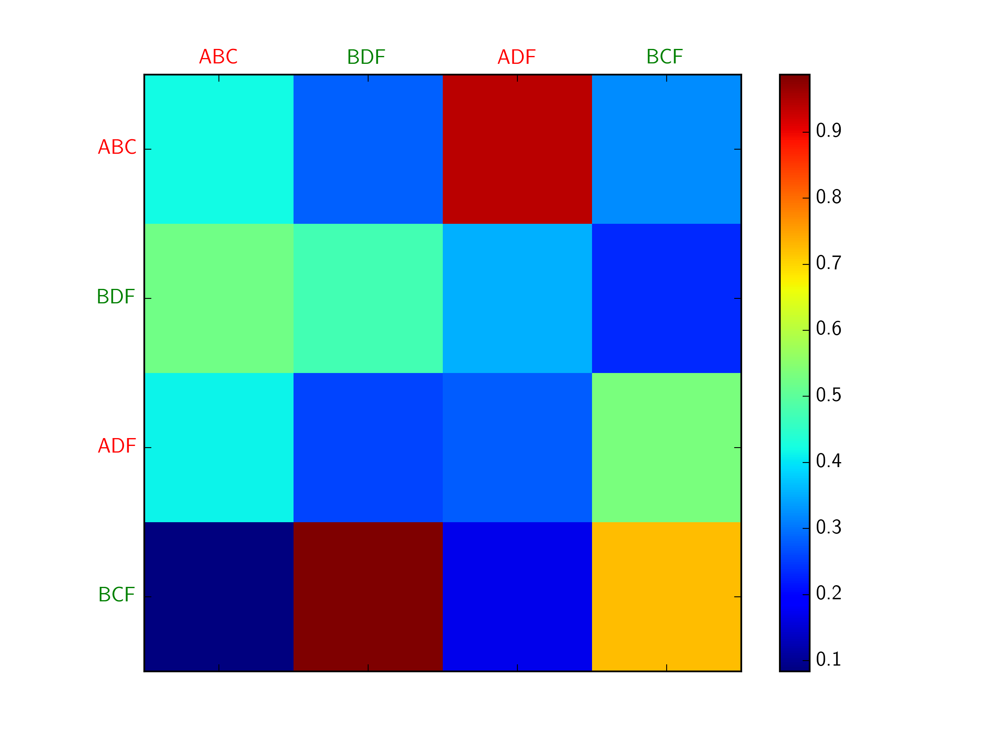
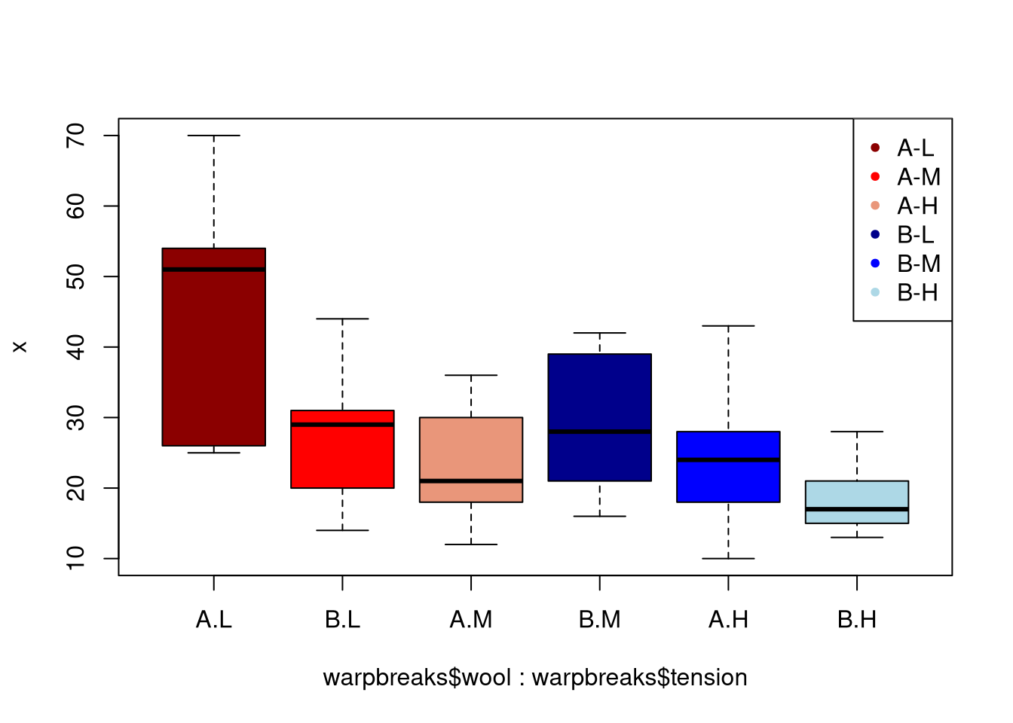
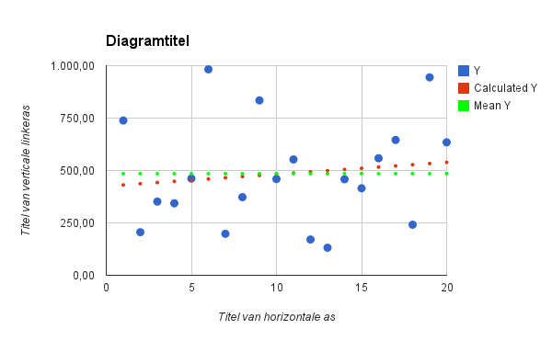
Visualization Types
Bar Chart
PIE CHART
LINE CHART
HISTOGRAM
HEATMAP
BOX PLOT
SCATTER PLOT
This Photo by Unknown Author is licensed under CC BY-NC

Slide 6
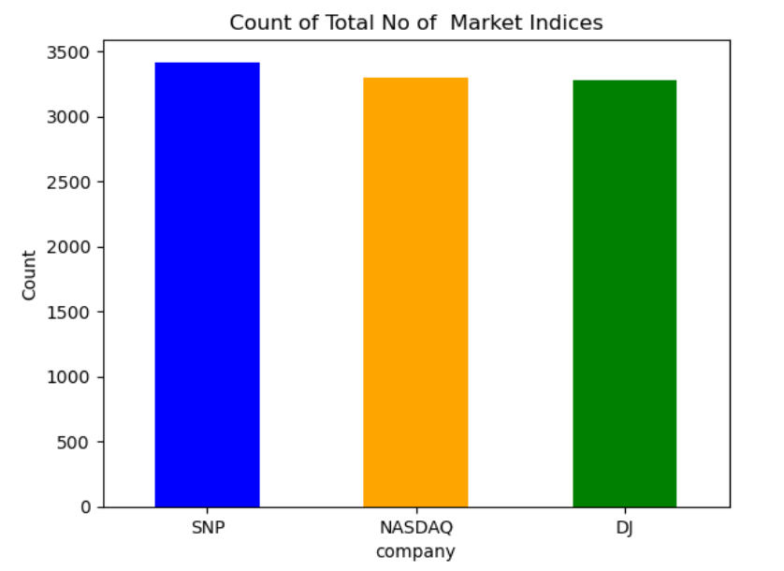
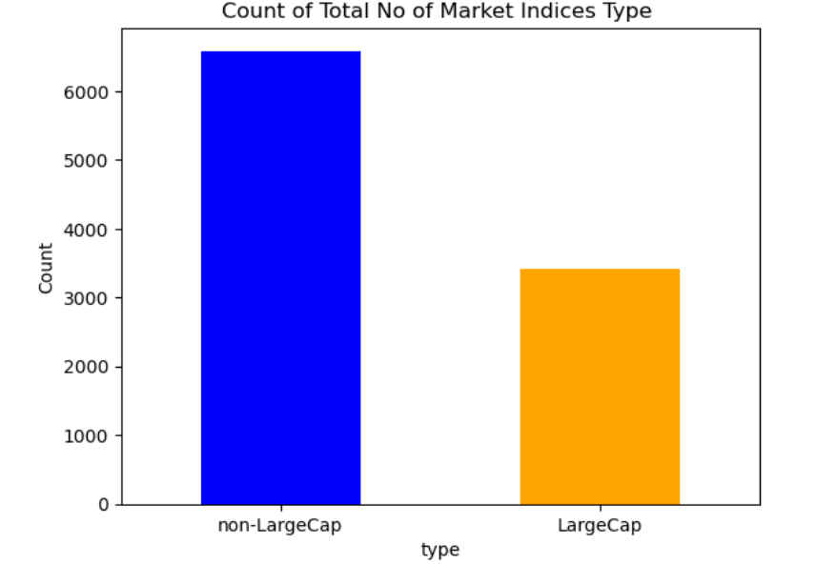
Bar Chart
Objective:
Visualize the Total no of companies
Inference:
Equal number of instances of 3 different companies have been considered with regards to their stock price and fluctuation rate.
Dominant presence of non-large companies in the dataset

Slide 7
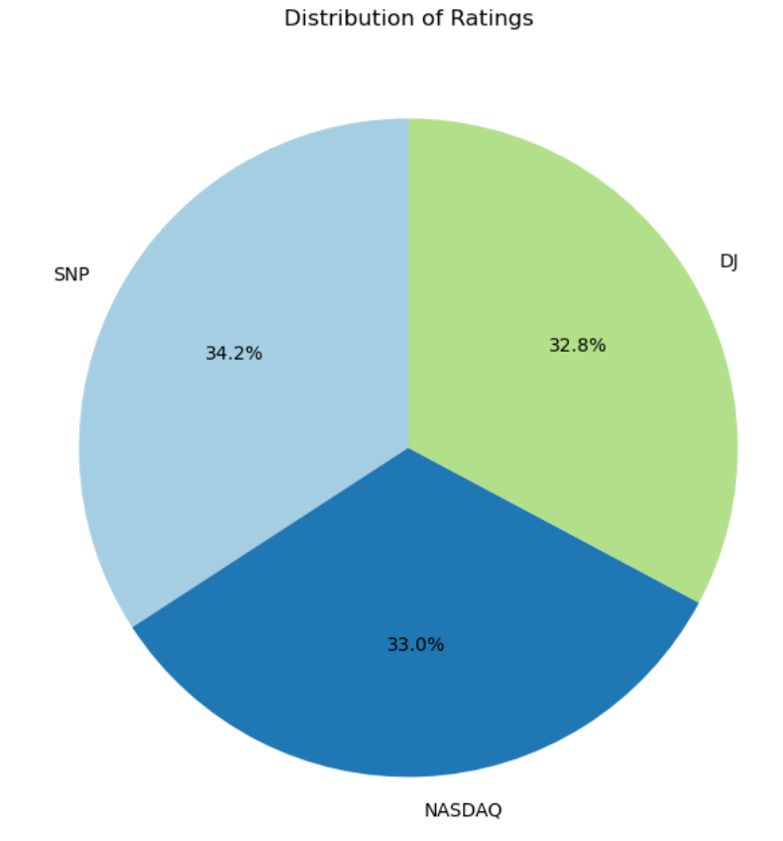
Pie Chart
Objective:
Visualize the relationship between companies’ performance levels
Trend:
The companies are categorized by performance levels.
A slice represents each company, and the size of each corresponds to the percentage of the whole.
Inference:
This pie chart distributes the companies by their category and their performance.
Each category represents a specific aspect criteria by which companies are classified. The performance of each company is depicted by the percentage of the pie slice

Slide 8
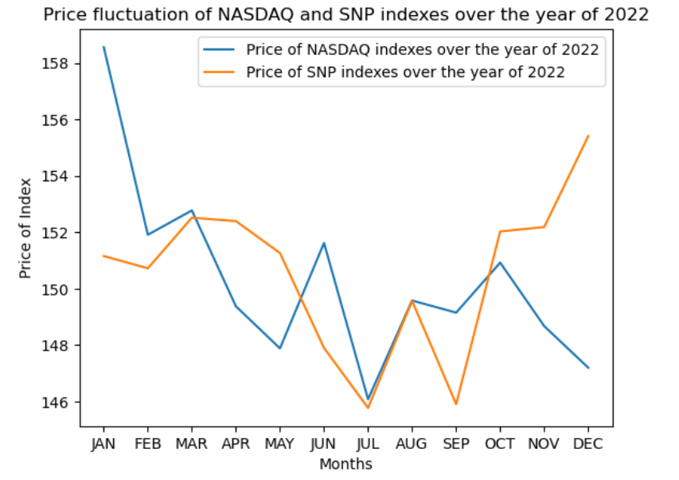
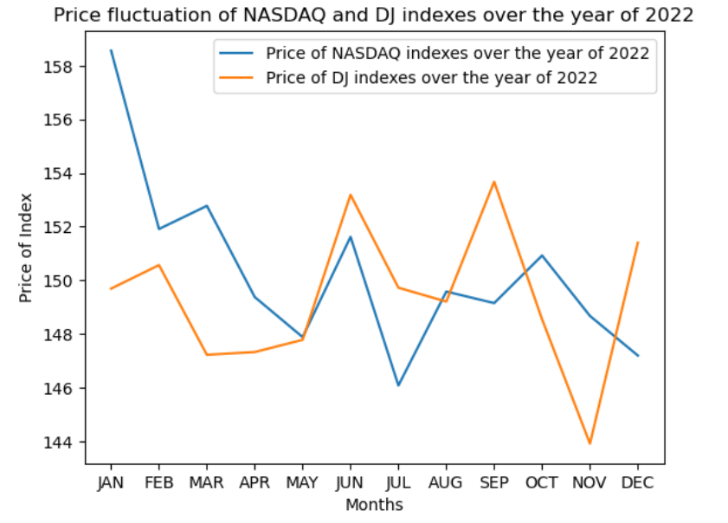
Line Chart
Objective:
Visualizing the price trends of different indexes over a year
Trend:
Prices tend to increase over the years but with some periodic drops.
There is noticeable volatility.
Inference:
Both the non-large cap indexes tend to move in similar trends they rise and dip in the same months.
Having a large cap doesn’t necessarily mean the company will outperform a company with a non-large cap.

Slide 9
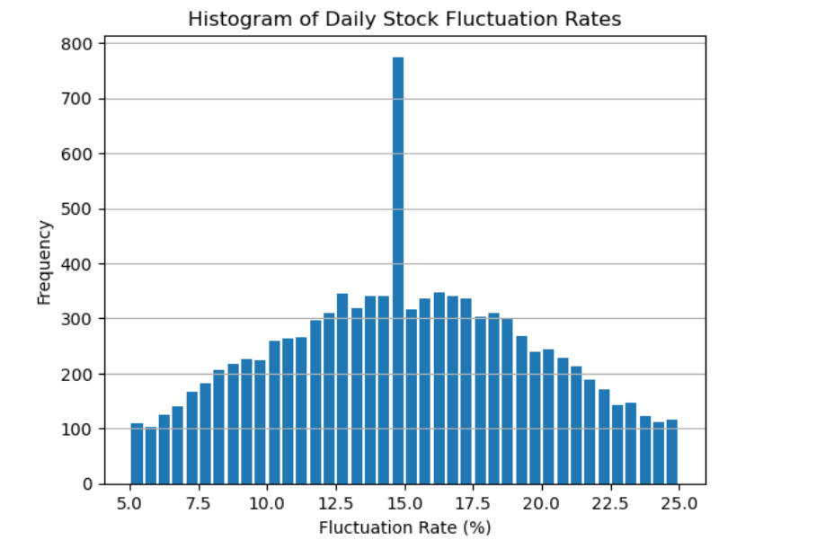
Histogram
Objective:
Visualize the distribution of fluctuation rate.
Trend:
Markets fluctuate fairly frequently.
The average fluctuation is about 15% during a year.
Inference:
The stock market fluctuates for a number of different reasons, but the biggest overall factor is supply and demand.
Prices of stocks rise when the supply of shares for sale is not enough to meet investors’ demands. When investors’ demand for shares falls, so does the price of the shares. This causes volatility.

Slide 10
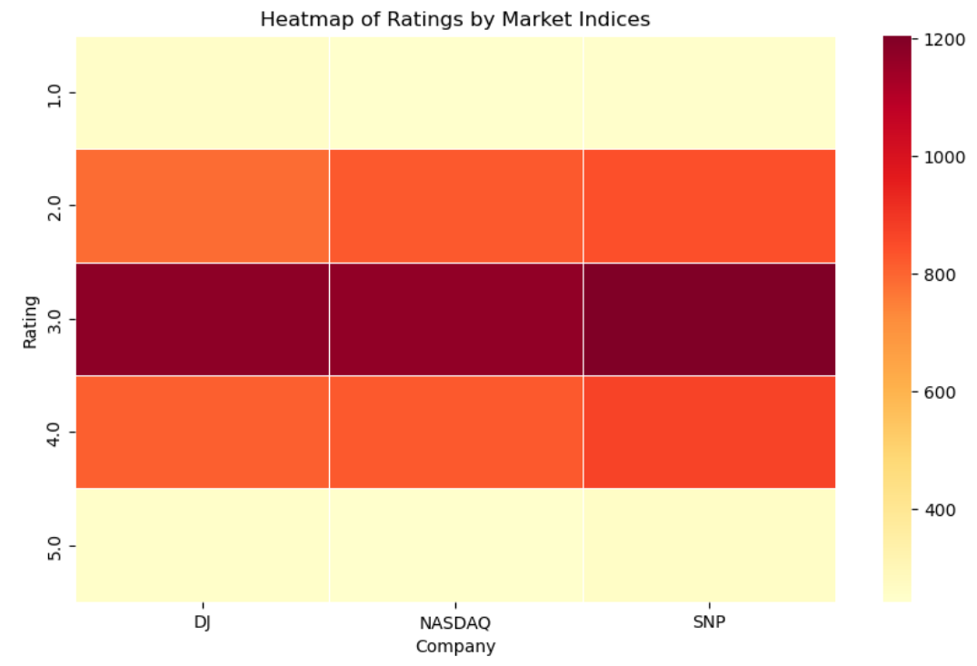
Heatmap
Objective:
Visualize and examine how ratings are distributed among the three indices.
Inference:
In every case, DJ, NASDAQ, and SNP get comparable ratings with SNP having a higher frequency of ratings 2,3 and 4 than DJ and NASDAQ.
For all three of the companies, the most common rating is 3.
From this we can say that investments made in all 3 indices can be considered as having the same level of risk associated with it as the most common rating associated with all of them is 3.

Slide 11
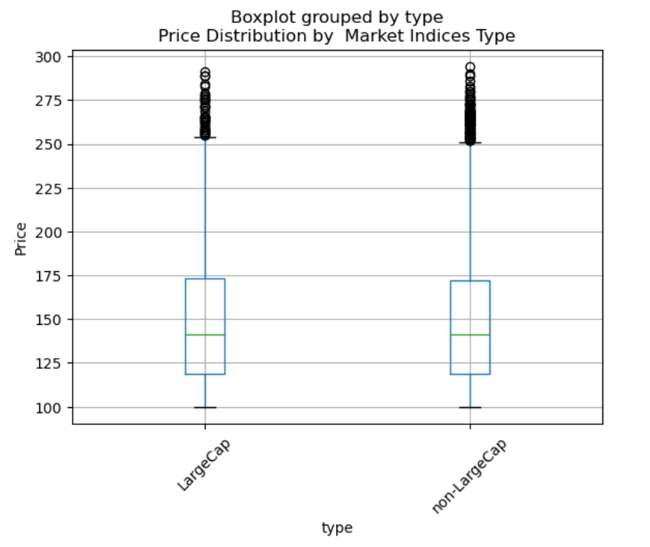
Box Plot
Objective:
Visualize the distribution of price of stocks concerning company type
Trend:
Almost an equal median for large-cap and non large cap indexes.
Inference:
Prices beyond 250$ are outliers
The type of the company doesn’t indicate causality on the price of their respective stocks

Slide 12
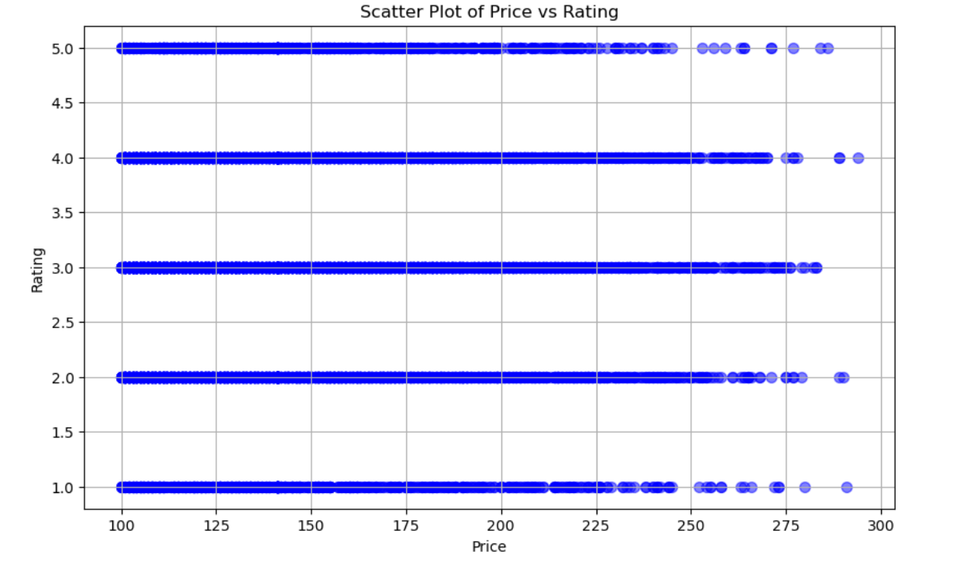
Scatter Plot
Objective:
Visualize the relationship between index price and rating
Trend:
There is a weak positive correlation between price and rating, where higher-priced indexes tend to have slightly higher ratings
Inference:
Weak positive correlation between Price and Rating
Index ratings are driven by more than just price, though higher prices may contribute slightly to better perceptions.

Slide 13

Conclusion
The data concludes that both the large-cap and non-large-cap stock market indexes perform at an equal rate and they don’t seem to outperform the other.
We could safely assume all the given stock market index moves are influenced by the market performance and economy.
There do not appear to be any severe anomalies or crashes present in this slice of data. Expanding the analysis to a longer time horizon could reveal more extreme events and test the strength of some of the hypothesized trends.

Slide 14
Thank you
Questions?

Slide 15

Wrap Up

